Slide 1

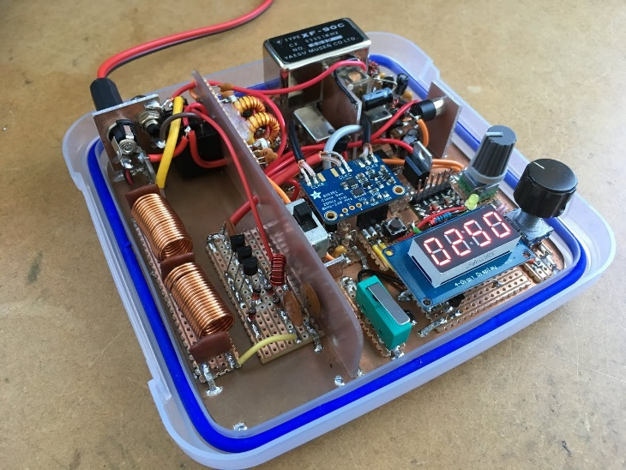

1.12 Software defined radio Initial Design Review
Sponsor: Texas State University
Faculty Advisor: Dr. Stapleton

Slide 2
Project Overview
Software Defined Radio High Frequency (HF) Transceiver
Non-Portable Half Duplex Radio Communications on the HF Band
Notes:
State the problem and the project in clear terms. Use a graphic if at all possible.

Slide 3
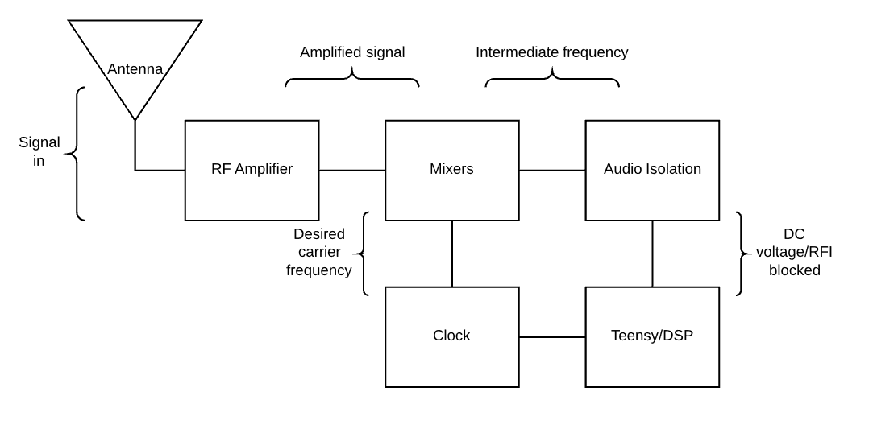
Top level block diagram

Slide 4
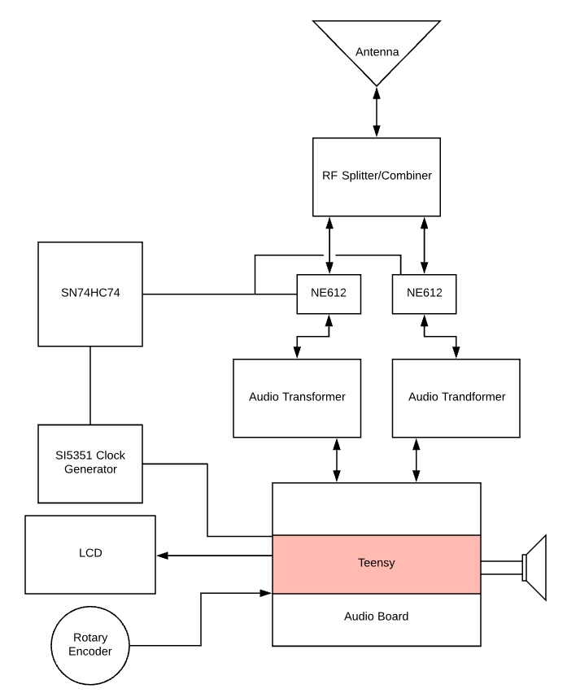
block diagram
NE612 : RF Mixers
SN74HC74 : D Flip Flop Network, Clock Divider and Quadrature Generator
SI5351: Voltage Controlled Oscillator, Sets the Carrier Wave Frequency
Audio Transformer: Audio Signal Isolator
Teensy: Main microcontroller, handles signal processing and tuning
Notes:
Put your project into the larger context.

Slide 5
Project Goals
Goals of Project
Stretch Goals of Project
To create a Half-Duplex Software Defined Radio
To make an educational tool
To make a PCB for the radio
To make it operable for 4 hours on 12V battery power
To make a build kit for the radio
3D printed Case for safety
Have an operable 3.5mm headphone Jack
Notes:
If no stretch goals then delete the text box on the right, and expand the one on the left. DO NOT ELABORATE ON THE GOALS, JUST STATE THEM QUICKLY AND MOVE ON!!!

Slide 6
Roles & Responsibilities
NAME | ROLE
James Bell, Project Manager | Coding for microcontroller
Samuel Hussey | SPICE design and simulations
Zachary Schneiderman | Circuit design and test
Notes:
BRIEF DESCRIPTIONS!!!!! Go over this VERY quickly!

Slide 7
Project-Specific Milestones
MILESTONE | Completion Date | Person(s)
Simulation of analog components | 10/22/18 | Samuel Hussey
Signal Flow chart | 10/22/18 | James Bell
Parts List and Specifications | 10/22/18 | Zachary Schneiderman
Order Parts | 10/25/18 | James Bell
Analog component testing | 11/19/18 | Zachary Schneiderman
Radio receive testing | 11/25/18 | James Bell
Radio transmit testing | 12/5/18 | Samuel Hussey
Notes:
List the major milestones. They are milestones SPECIFIC to YOUR project and NOT deliverables for the class!!!

Slide 8

Project Deliverables
Analog component simulations
Analog component testing
Digital signal processing testing
Radio receiving test and verification
Radio transmission test and verification
Notes:
List the MAJOR deliverables only. These are the deliverables for your PROJECT and NOT for the class! E.g., don’t list “Functional Spec” etc.

Slide 9
Functional Specification Review

Slide 10
2.3 Error Handling
We will bound the tunable frequencies by looping the frequency selector over the 3.500MHz – 4.000MHz range and the 14.000MHz – 14.350MHz range.
A multi pole turn switch will be set by the user to correspond to their license level, this will limit some functionality of the radio
Notes:
Talk to this slide for no more than 1 minute! Remember: ALL designs must handle errors! You may have to think about what they might be!

Slide 11
2.4 Safety & Security
A case will be used to limit accidental contact with components
An LED power indicator will be visible to warn the user the device is on.
Notes:
If this section is not relevant to your project then delete this slide. If relevant, talk to this slide for no more than 1 minute!

Slide 12
2.61 – User Interfaces
Control components (Rotary switches, Rotary encoder, potentiometer, and multi pole switches) will be accessible to modify operation
An LED screen will be visible to allow the user to see frequency selection or other digital choices.
Notes:
These are interfaces between the USER and your SYSTEM.

Slide 13
2.62 – Software Interfaces
The Teensy and Audio Shield to communicate over I2S
Arduino IDE (1.8.7) with Teensy loader application (1.44) to create, compile, and load code
Stretch goal: Raspbian operating system.
Notes:
These are interfaces between one piece (or language) of software and another due to your design. If this section is not relevant to your project then delete this slide.

Slide 14
2.63 – Hardware Interfaces
The Teensy and audio shield will be connected to the rotary encoder, LCD, SI5351 clock generator, audio transformers, microphone, and speaker
The antenna will feed the received signal into the NE612 mixers which will then interface with the SN74HC74 and SI5351
Notes:
These are interfaces between two pieces of hardware, e.g., you connected a sensor to a pi. If this section is not relevant to your project then delete this slide.

Slide 15
2.7 Boundary Conditions & Constraints
Boundary | Constraint
The radio will only operate on frequencies from 3.5-4.0MHz and 14.00-14.35MHz | The radio can tune to any frequency on the HF band, 3Mhz to 30Mhz
Boundary | Constraint
The Teensy will amplify the microphone signals from 0-20dB | The Teensy can amplify the microphone signals by 0-63dB
Boundary | Constraint
The typical transmit power will be between 18-25mW | The maximum transmit power cannot exceed 31mW
Boundary | Constraint
The radio will transmit signals from the microphone to the antenna in under 100ms | The radio cannot exceed a 500ms delay as it would make radio conversation difficult
Boundary | Constraint
The device should operate around the US specification of 120V AC 60Hz | The input power must be minimum 100V AC 50Hz, and cannot exceed 240V AC 60Hz
Boundary | Constraint
The RF Amplifiers Gain will be 15-20 at 3.5MHz and 12-15 at 14.5MHz | The RF Amplifiers Gain cannot exceed 60 over the 3.5-14.5MHz band
Notes:
List the boundary conditions and make sure your Sponsor agrees that they are indeed boundary conditions. Talk to this slide for no more than 1 minute!

Slide 16
2.8 Performance
Will operate on 12VDC from power supply connected to outlet
BP filters and Teensy will only allow reception/transmission of 3.5MHz-4.0MHz and 14.0MHz-14.35MHz
Latency under 100ms
Notes:
This is where you need to spend the majority of your time. You’ll need several slides to cover 2.13.

Slide 17
2.9 Software Platforms
Arduino environment 1.8.7, with the Teensy loader application 1.44 addon on windows 10,
Stretch goal: Raspbian
Notes:
What platforms does your system run on? If this section is not relevant to your project then delete this slide. If relevant, talk to this slide for no more than 1 minute!

Slide 18
2.10 Service, Support & Maintenance
A repository of code by version of schematic will be available on a repository.
Components will be easy to access, and clean.
Notes:
What platforms does your system run on? If this section is not relevant to your project then delete this slide. If relevant, talk to this slide for no more than 1 minute!

Slide 19
2.11 Expandability or Customization
The device will be an educational tool, meaning it can be easily modified, expanded, or customized in any way the user sees fit but is not designed with that in mind. Only the initial schematics and code for the microcontroller will be provided.
Notes:
What platforms does your system run on? If this section is not relevant to your project then delete this slide. If relevant, talk to this slide for no more than 1 minute!

Slide 20
Challenges & Concerns
Our simulations are not matching our actual devices
The amplifier simulation is not matching the actual build
An additional power amplifier will be necessary
The original design will not be able to transmit long distances
Notes:
Word this carefully – OK to ask questions and seek resolution during the IDR. CLASS DELIVERABLES and/or team meetings ARE *NOT* CHALLENGES!!!

Slide 21
Project Progress
Simulations of analog components completed for:
Radio Frequency Amplifier
Band Pass Filters
Analysis of electronic components completed for:
Amplifier
Research completed for:
Signal flow through device
Notes:
Go through this at a good pace. You could spend 30 minutes on this alone – don’t. Just give an overview.

Slide 22
Future Tasks
Tasks Planned for the Completion of the project:
Order parts
Assemble analog components
Test analog components against simulations
Test digital signal processing
Combine parts for Software Defined Radio
Received signal test for Software Defined Radio
Notes:
High level tasks! DO NOT enter items like, “order 100 ohm resistors.”

